Slide 1
Introduction to structured query language (SQL)
Fernando Pombeiro
Manager, BI Engineering, Fandango

Slide 2

SO WHAT BRINGS YOU HERE TONIGHT?
Introductions!
Notes:
learning objectives will frame the class and give students reference points

Slide 3
Learning objectives
Introduction to SQL
Understand Database Structures
SQL tables- what are they?
JOINS- why do people always talk about them?
Some cool stuff you can do
Notes:
learning objectives will frame the class and give students reference points

Slide 4
Intro to SQL
Databases and their structures

Slide 5

Database Structures and RANks
Let’s start at the top: SERVERS
The server is basically the machine that serves up the data on request. THIS is what you connect to when you “connect to SQL”
A server contains multiple databases
In SQL we CAN start rank structures with “SERVER”
Notes:
5m
Last time you interviewed each other about {prompt from Lesson 1}, and we ended with you deciding what the problem actually was after your research interviews.
Now we’re going to take that problem and work through some solutions.

Slide 6

Database Structures and RANks
SECOND in command: DATABASES
Each SERVER can contain multiple DATABASES.
You hook up to the SERVER and then choose which DATABASE you need.
Most SERVERS contain databases that do different things: DB1 might have TRANSACTION data
DB2 might have Page view data.
Notes:
5m
Last time you interviewed each other about {prompt from Lesson 1}, and we ended with you deciding what the problem actually was after your research interviews.
Now we’re going to take that problem and work through some solutions.

Slide 7
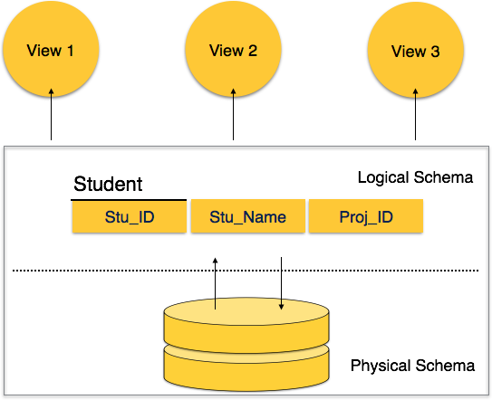
Database Structures and RANks
THIRD in command: SCHEMAS
SCHEMAS are like various subjects within a database
So in your database for TRANSACTIONS you might have a setup where SCHEMA 1 is just CREDIT CARDS and SCHEMA 2 is PAYPAL and so on
Notes:
5m
Last time you interviewed each other about {prompt from Lesson 1}, and we ended with you deciding what the problem actually was after your research interviews.
Now we’re going to take that problem and work through some solutions.

Slide 8
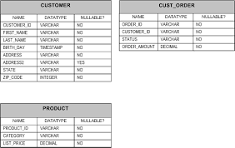
Database Structures and RANks
FOURTH in command: TABLES
FOURTH in our rank structure we get to TABLES.
SQL tables are JUST EXCEL SPREADSHEETS- think of them that way!
A SCHEMA can have multiple TABLES in it.
(Think excel WORKBOOK with several SHEETS)
Notes:
5m
Last time you interviewed each other about {prompt from Lesson 1}, and we ended with you deciding what the problem actually was after your research interviews.
Now we’re going to take that problem and work through some solutions.

Slide 9

Database Structures and RANks
FIFTH in chain of command: COLUMNS
For anyone that’s ever utilized EXCEL you’ve probably noticed that excel is made up of COLUMNS and ROWS (and where they intersect- CELLS)
Obviously- a table can have multiple COLUMNS
Notes:
5m
Last time you interviewed each other about {prompt from Lesson 1}, and we ended with you deciding what the problem actually was after your research interviews.
Now we’re going to take that problem and work through some solutions.

Slide 10
Bringing it all together!
So let’s bring all these together:
SQL and DATABASES are all about logical structures- think of RANKS in the military. When we talk about an SQL location we break it down like this:
Server.Database.Schema.Table.Column
Note the periods in between each section-> this is how we designate each portion- like an address– from country down to street down to house.
Notes:
5m
Last time you interviewed each other about {prompt from Lesson 1}, and we ended with you deciding what the problem actually was after your research interviews.
Now we’re going to take that problem and work through some solutions.

Slide 11
Intro to SQL
Table structures in SQL

Slide 12
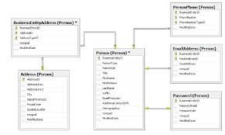
Table organization
Most companies that utilize SQL use some kind of basic and easy to understand SQL table structure
Think of excel spreadsheets that you use- one might have transactions by day and another has data about customers…
Notes:
5m
Last time you interviewed each other about {prompt from Lesson 1}, and we ended with you deciding what the problem actually was after your research interviews.
Now we’re going to take that problem and work through some solutions.

Slide 13
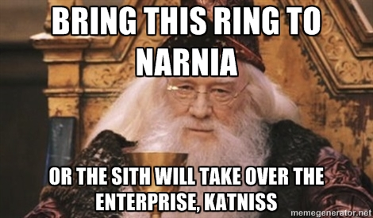
Table organization
So let’s say you were running an online store for J.K Rowling
Let’s say that your e-commerce shop was set up to sell wizarding items. What are some spreadsheets that you can see yourself keeping around? Please take five and list them.
Notes:
5m
Last time you interviewed each other about {prompt from Lesson 1}, and we ended with you deciding what the problem actually was after your research interviews.
Now we’re going to take that problem and work through some solutions.

Slide 14
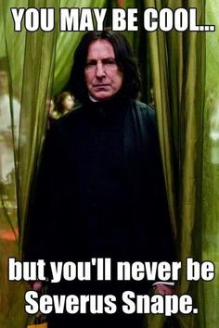
Table organization
Here’s one suggestion- and what the tables would contain:
Table name: Customers
Column 1: Customer first name
Column 2: Customer last name
Column 3: Customer Address
Column 4: Customer Gender
Column 5: Customer House
Table 2 name: Items
Column 1: Item name
Column 2: Item cost
Column 3: Item weight
Table 3 name: Transactions:
Column 1: Date of sale
Column 2: Item number
Column 3: Quantity of item
Column 4: COST of item
Notes:
5m
Last time you interviewed each other about {prompt from Lesson 1}, and we ended with you deciding what the problem actually was after your research interviews.
Now we’re going to take that problem and work through some solutions.

Slide 15
Table organization
So picture each of these tables as spreadsheets- with each column header representing the name and each row the data. So for table CUSTOMERS, for example:
CUSTOMERS
Customer Number | First Name | Last Name | Address | Gender | House
1 | Darth | Vader | 1 Death Star Row, Death Star, Space | Male/Cyborg | Sith
2 | James | Kirk | Enterprise | Male | Federation
3 | Kermit | Frog | Swamp | Male | Muppets
Items
Item Number | Item Name | Description | Cost | Dimensions
1 | Bow and Arrow | Useful for saving Luke Skywalker from the Hunger games | $200 | Big
Notes:
5m
Last time you interviewed each other about {prompt from Lesson 1}, and we ended with you deciding what the problem actually was after your research interviews.
Now we’re going to take that problem and work through some solutions.

Slide 16
Table organization
And our transaction table:
Date of purchase | Time of purchase | Customer Number | Item Number | Item purchased | Qty of Items purchased | Customer who purchased | Total cost of transaction
2016-10-11 | 5pm | 22 | 67 | Sneetch | 1 | Bender | $100
2016-10-12 | 4:30pm | 46 | 119 | Thor’s Hammer | 1 | Kylo Ren | $500
2016-10-14 | 7am | 100 | 758 | Butter Beer | 6 | Spock | $30
Notes:
5m
Last time you interviewed each other about {prompt from Lesson 1}, and we ended with you deciding what the problem actually was after your research interviews.
Now we’re going to take that problem and work through some solutions.

Slide 17
Table organization
When we get enough of these tables together we get an RDBMS or Relational DataBase Management System
The RDBMS just describes how each of these tables is connected- specifically what column they have in common
So in our example the CUSTOMER shows up in both the CUSTOMER table AND the Transaction table. The ITEM Number shows up in the ITEM table and the Transaction table. They can be connected in these tables with JOINS.
Notes:
5m
Last time you interviewed each other about {prompt from Lesson 1}, and we ended with you deciding what the problem actually was after your research interviews.
Now we’re going to take that problem and work through some solutions.

Slide 18
Intro to SQL
Talking to tables (sql language)

Slide 19

SQL qUeries
So now we have all of these tables set up but we want to get data OUT of them.
We want to query the tables in order to receive data from them. We write queries in SQL and then submit them to the server.
The server sends around a little dude (not literally) to collect all of the information that you want to get back (it’s useful to think of things this way…more on this later)
In order to talk to the tables you have to connect to them through a Graphical User Interface (or GUI- pronounced “gooey”).
There are numerous free GUIs out there and most flavors of SQL come with their own (WORKBENCH for MYSQL, PGADMIN for POSTGRESQL, etc)
Notes:
5m
Last time you interviewed each other about {prompt from Lesson 1}, and we ended with you deciding what the problem actually was after your research interviews.
Now we’re going to take that problem and work through some solutions.

Slide 20
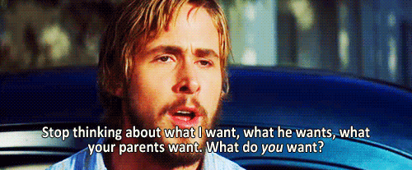
SQL qUeries
SQL Queries follow a standard format, broken down by “clauses”.
You will frequently see these clauses broken down on different lines for ease of reading.
Here are the basic clauses that go into a SQL query:
SELECT
FROM
JOIN
WHERE
GROUP BY
HAVING
ORDER BY
LIMIT
Notes:
5m
Last time you interviewed each other about {prompt from Lesson 1}, and we ended with you deciding what the problem actually was after your research interviews.
Now we’re going to take that problem and work through some solutions.

Slide 21

SELECT clause
The SELECT clause marks the beginning of every SQL query.
It basically lays out the structure of the table that will be returned (all SQL answers come in the form of tables).
You have a few options- you can say
SELECT customer_first_name, customer_last_name,
OR you can say “give me EVERYTHING!”- which, in shorthand, is:
SELECT *
Notes:
5m
Last time you interviewed each other about {prompt from Lesson 1}, and we ended with you deciding what the problem actually was after your research interviews.
Now we’re going to take that problem and work through some solutions.

Slide 22

FROM clause
So now you’ve chosen what columns you want from your SQL table- let’s talk about WHERE.
OBVIOUSLY SQL needs to know WHAT table to pull data from. THIS is where the full address (that we mentioned before):
SELECT * FROM Server.database.schema.Customers
The FROM clause is very basic when dealing with just ONE table– but when dealing with TWO tables you might need to JOIN them.
Notes:
5m
Last time you interviewed each other about {prompt from Lesson 1}, and we ended with you deciding what the problem actually was after your research interviews.
Now we’re going to take that problem and work through some solutions.

Slide 23
JOIN clause
Now- sometimes we will need to JOIN two tables together here. In order to do this we will need to find something that the two tables have in COMMON. So in our example- we have the Transaction table which has columns in common with the Customer table (on CUSTOMER_ID)
So when we do a join we say:
SELECT *
FROM
Customers
JOIN
Transactions ON (Customers.customer_id = Transactions.Customer_id)
Notes:
5m
Last time you interviewed each other about {prompt from Lesson 1}, and we ended with you deciding what the problem actually was after your research interviews.
Now we’re going to take that problem and work through some solutions.

Slide 24

WHERE Clause
In our query the WHERE clause is basically a filter.
It is our way of telling the database “Return ONLY rows that match up with this criteria”
The WHERE clause can do “equals, greater than, less than, AND, OR, between” statements.
So to continue our query- let’s pretend that we only want to return customers from house GRYFFINDOR. We might do something like:
SELECT *
FROM
Customers
WHERE
Customer_house = ‘Gryffindor’
This will give us ALL
Notes:
5m
Last time you interviewed each other about {prompt from Lesson 1}, and we ended with you deciding what the problem actually was after your research interviews.
Now we’re going to take that problem and work through some solutions.

Slide 25
GROUP BY Clause
The GROUP BY clause is a little bit complicated. Basically it says “we are going to reduce the number of rows (by COUNTING THEM or SUMMING them, for example) and then limiting them by GROUP
SO- in our example- let’s say we wanted a COUNT of students by HOUSE in our STUDENTS table:
SELECT
customer_house,
COUNT(first_name)
FROM
Customers
GROUP BY
customer_house
This will return something like this:
House | Students
Gryffindor | 120
Hufflepuff | 200
Ravenclaw | 72
Slytherin | 165
Notes:
5m
Last time you interviewed each other about {prompt from Lesson 1}, and we ended with you deciding what the problem actually was after your research interviews.
Now we’re going to take that problem and work through some solutions.

Slide 26

HAVING CLAUSE
The HAVING clause is like a second filter.
There are certain things that we can’t do in the WHERE clause- for instance- we can’t say “count all students and return houses WHERE there are more than 100 students”
You can’t do this: SELECT
customer_house,
count(first_name)
FROM
Customers
WHERE
count(first_name) > 100
GROUP BY
customer_house
The HAVING clause will allow you to run the query but just SHOW items > 100
Notes:
5m
Last time you interviewed each other about {prompt from Lesson 1}, and we ended with you deciding what the problem actually was after your research interviews.
Now we’re going to take that problem and work through some solutions.

Slide 27
ORDER BY CLAUSE
The ORDER BY clause basically decides what column should decide the order that things come back in.
You have two options: asc or desc (ascending or descending).
So if you wanted to order the number of customers by house you might do something like this:
SELECT
customer_house,
count(first_name)
FROM
Customers
GROUP BY
customer_house
ORDER BY
count(first_name) desc
House | Customers count
Slytherin | 240
Gryffindor | 180
Hufflepuff | 155
Ravenclaw | 104
Notes:
5m
Last time you interviewed each other about {prompt from Lesson 1}, and we ended with you deciding what the problem actually was after your research interviews.
Now we’re going to take that problem and work through some solutions.

Slide 28
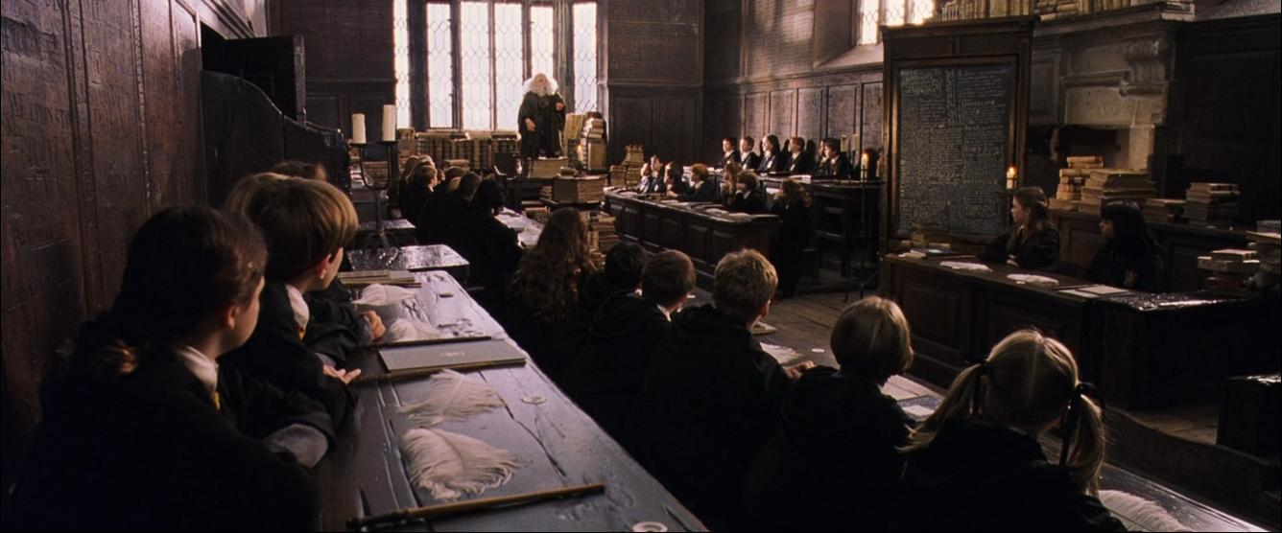
LIMIT CLAUSE
What if we have a TON of data coming back (like, over 1,000,000 rows?). This is where the LIMIT clause comes in handy
We can LIMIT the amount of rows we return by saying “just 100 rows” or LIMIT 100
So for JUST the top 100 customers (ordered alphabetically by name):
SELECT *
FROM
customers
ORDER BY first_name asc
LIMIT 100;
Notes:
5m
Last time you interviewed each other about {prompt from Lesson 1}, and we ended with you deciding what the problem actually was after your research interviews.
Now we’re going to take that problem and work through some solutions.

Slide 29
Now let’s bring it all together
So everyone try to parse this statement (what is it telling me?)
SELECT
customer_name,
SUM(total_cost_of_transaction)
FROM
customer
JOIN
transactions on (transaction.customer_id = customer.customer_id)
WHERE
customer_house = ‘Gryffindor’
GROUP BY
customer_name
ORDER BY SUM(total_cost_of_transaction) desc
LIMIT 100;
Notes:
5m
Last time you interviewed each other about {prompt from Lesson 1}, and we ended with you deciding what the problem actually was after your research interviews.
Now we’re going to take that problem and work through some solutions.

Slide 30

Now let’s bring it all together
Please list all of the parts of a SQL query
What does the “WHERE” clause do again?
When I “GROUP BY” something- what am I doing?
One more thing…
There are two types of data- there is data that is MOVING and being UPDATED CONSTANTLY (in our example- the TRANSACTION table).
ONE customer can have MULTIPLE transactions (for example)
But MULTIPLE CUSTOMERS can’t have ONE transaction- right?
Notes:
5m
Last time you interviewed each other about {prompt from Lesson 1}, and we ended with you deciding what the problem actually was after your research interviews.
Now we’re going to take that problem and work through some solutions.

Slide 31
Now let’s bring it all together
Keep this one-to-many thing in mind and you can realize that there are basically two TYPES of tables:
DIMENSION tables: where there is one entry per customer, per product, per…whatever.
TRANSACTION tables: These are tables that link to DIMENSION tables (on a common column). These are the ones where a single DIMENSION (customer, item, etc) can appear in the TRANSACTION table multiple times.
In most databases these tables are denoted by “dim_customer” or “Transactions_August”…something like that.
Notes:
5m
Last time you interviewed each other about {prompt from Lesson 1}, and we ended with you deciding what the problem actually was after your research interviews.
Now we’re going to take that problem and work through some solutions.

Slide 32
Intro to SQL
Connecting to a SQL database

Slide 33
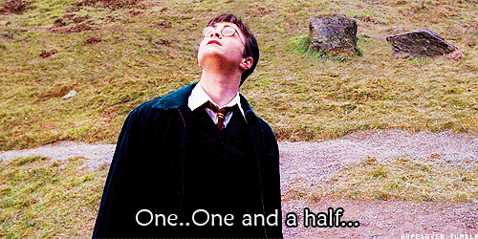
Connecting to a sql data
SQL comes in many forms:
MYSQL
POSTGRESQL
MSSQL
T-SQL
ORACLE-SQL
And many, many more…
For all intents and purposes at this stage of your SQL development- what is the difference in these SQL types?
Notes:
5m
Last time you interviewed each other about {prompt from Lesson 1}, and we ended with you deciding what the problem actually was after your research interviews.
Now we’re going to take that problem and work through some solutions.

Slide 34
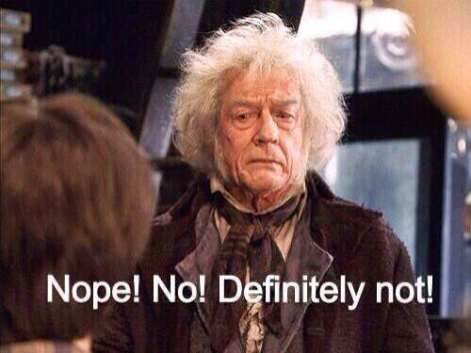
Connecting to a sql data
At your current level it is safe to treat them exactly the same
Here is a complete list of differences in types of SQL (at your level- at very advanced SQL queries the differences show up).
Notes:
5m
Last time you interviewed each other about {prompt from Lesson 1}, and we ended with you deciding what the problem actually was after your research interviews.
Now we’re going to take that problem and work through some solutions.

Slide 35
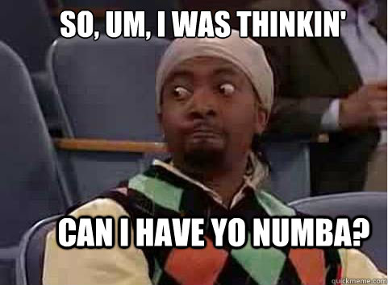
Connecting to a sql data
Knowing that- what do you need to connect to SQL?
An Address for the SQL server (it can be an IP address)
A username and password
Permissions (from your local Database Administrator) to access the database
A Graphical User Interface
Notes:
5m
Last time you interviewed each other about {prompt from Lesson 1}, and we ended with you deciding what the problem actually was after your research interviews.
Now we’re going to take that problem and work through some solutions.

Slide 36
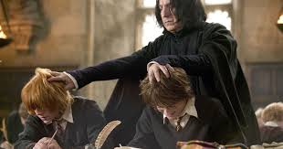
Connecting to a sql data
So why is my DBA so so mean and refuses to give me access?
Keep in mind that Databases are a shared resource. If too many people are querying at the same time you can affect performance negatively. Remember this guy? He only has limited abilities to bring people stuff.
Notes:
5m
Last time you interviewed each other about {prompt from Lesson 1}, and we ended with you deciding what the problem actually was after your research interviews.
Now we’re going to take that problem and work through some solutions.

Slide 37
Connecting to a sql data
That being said: SQL is EVERYWHERE right now.
When you put your name into a username bar in Facebook- in the background this is what’s happening:
SELECT * FROM tblCustomers where username = ‘yourusername’;
That’s because Facebook is built on the LAMP stack (Linux, Apache, MYSQL, PHP)
Notes:
5m
Last time you interviewed each other about {prompt from Lesson 1}, and we ended with you deciding what the problem actually was after your research interviews.
Now we’re going to take that problem and work through some solutions.

Slide 38
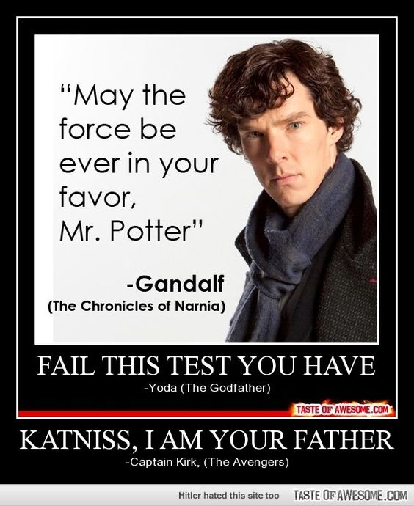
Summary
CONFUSED?
Good- ASK QUESTIONS!
Notes:
5m
Last time you interviewed each other about {prompt from Lesson 1}, and we ended with you deciding what the problem actually was after your research interviews.
Now we’re going to take that problem and work through some solutions.

